Slide 1
Web-based Information System
A web-based information system (WIS) refers to any system that uses web technologies to deliver and manage information.
These systems are accessed through a web browser and can range from simple applications like online forms to complex enterprise-level systems.

Slide 2
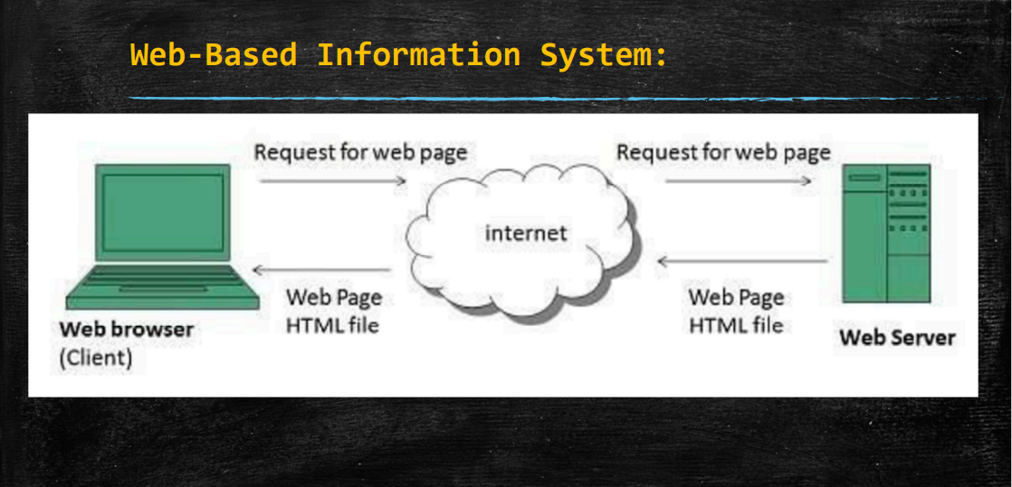

Slide 3
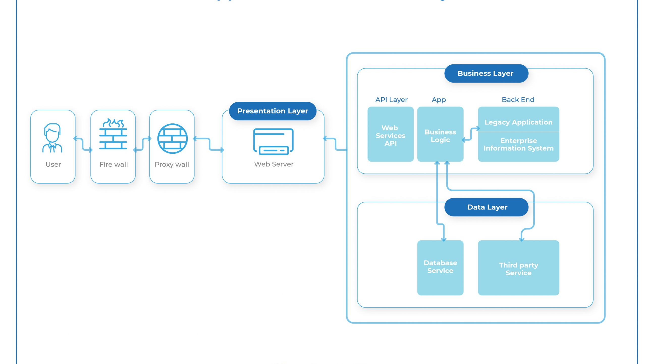

Slide 4
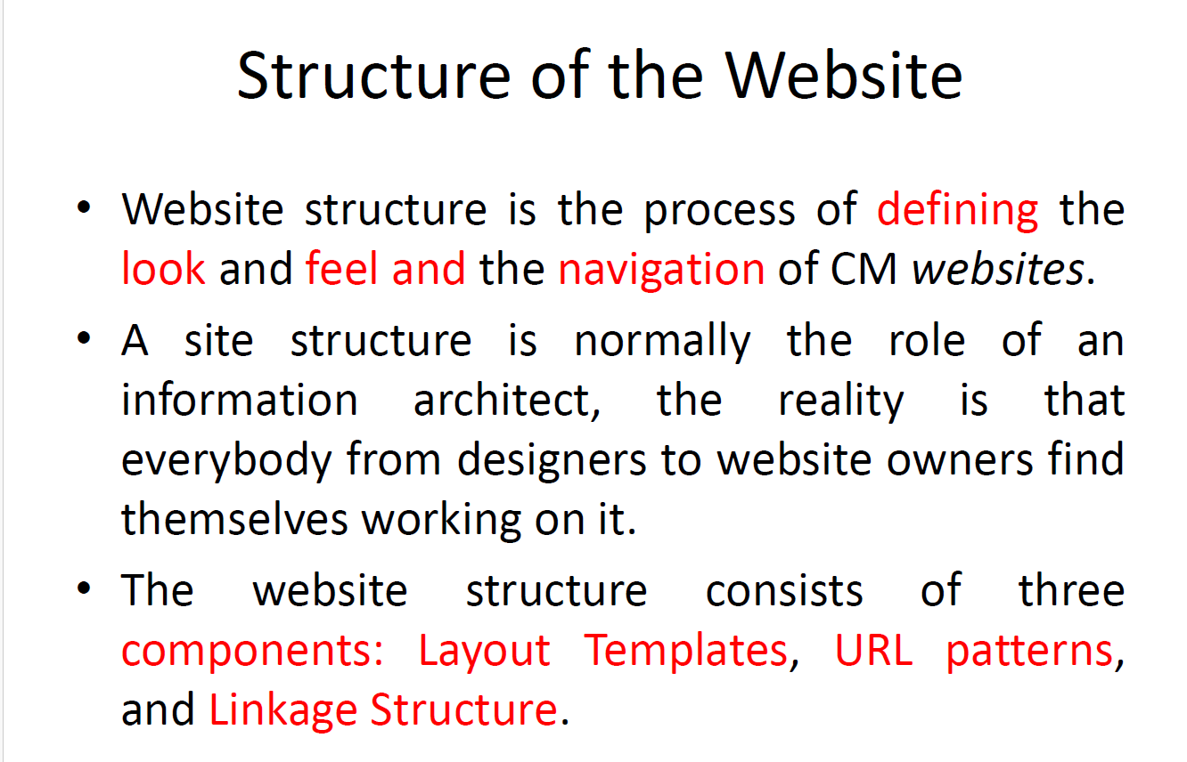

Slide 5
Components of a Web-Based Information System
User Interface (UI): The front-end of the system that users interact with through a web browser. It includes forms, menus, dashboards, and other elements for data input, display, and interaction.
Backend Server: The server-side components that process user requests, manage data, and execute business logic. This often includes a web server, application server, and database server.
Database: Stores and manages the system’s data. It could be a relational database (e.g., MySQL, PostgreSQL) or NoSQL database (e.g., MongoDB, Redis) depending on the application requirements.
Networking: Enables communication between the client (user’s web browser) and server, typically using HTTP/HTTPS protocols.
Security: Implements authentication, authorization, encryption, and other measures to protect data and ensure secure access.

Slide 6
Benefits of Web-Based Information Systems
Accessibility: Users can access the system from any location with internet access, promoting remote work and collaboration.
Scalability: Web-based systems can scale easily to accommodate growing numbers of users and data volumes.
Cross-Platform Compatibility: Works on various devices and operating systems without requiring installation of client-side software.
Centralized Updates: Updates and upgrades can be implemented centrally on the server, ensuring consistency and reducing maintenance efforts.
Integration: Can integrate with other systems and APIs to share data and functionality seamlessly.

Slide 7
Examples of Web-Based Information Systems
Enterprise Resource Planning (ERP) Systems: Used for managing various business processes such as finance, human resources, and inventory across an organization. Examples include SAP ERP and Oracle ERP Cloud.
Customer Relationship Management (CRM) Systems: Manage customer interactions and relationships, including sales, marketing, and customer support. Examples include Salesforce and HubSpot CRM.
Content Management Systems (CMS): Facilitate the creation, management, and publishing of digital content on websites. Examples include WordPress and Drupal.
Learning Management Systems (LMS): Used by educational institutions and businesses to deliver online courses and training programs. Examples include Moodle and Canvas.
E-commerce Platforms: Enable online buying and selling of goods or services. Examples include Shopify and WooCommerce.

Slide 8
Example Scenario: Online Banking System
Purpose: A bank’s online banking system serves as a web-based information system to provide customers with access to their accounts and banking services.
Components:
User Interface: Secure login page, account summary dashboard, transaction history, bill payment forms.
Backend Server: Handles user requests, manages account data, executes transactions securely.
Database: Stores customer account information, transaction records, and security logs.
Security: Two-factor authentication, encryption of sensitive data (e.g., passwords, transaction details).

Slide 9
Benefits:
Accessibility: Customers can check balances, transfer funds, and pay bills anytime from any location.
Scalability: Handles thousands of simultaneous transactions securely.
Integration: Links with payment gateways, other banking systems, and financial APIs.
Security: Ensures customer data protection and compliance with banking regulations.

Slide 10
Components of Web
Hypertext Transfer Protocol (HTTP):
Definition: HTTP is the protocol used for transmitting hypertext (text with hyperlinks) over the internet. It defines how messages are formatted and transmitted between web servers and browsers.
Role: Facilitates communication and data exchange between clients (web browsers) and servers (web servers).
Uniform Resource Locator (URL):
Definition: A URL is the web address used to identify and access resources on the internet. It specifies the protocol (e.g., HTTP, HTTPS), domain name (e.g., www.example.com), and path to the resource (e.g., /index.html).
Role: Provides a standardized way to locate and retrieve web pages, images, videos, documents, and other resources.
Hyperlinks:
Definition: Hyperlinks (or links) are elements in a web page that allow users to navigate between different web pages or resources by clicking on them.
Role: Establishes connections and facilitates navigation within and across websites, contributing to the interconnected structure of the web.

Slide 11
Components of Web
Hypertext Markup Language (HTML):
Definition: HTML is the standard markup language used to create and structure web pages. It defines the content and layout of text, images, links, forms, and other elements on a web page.
Role: Enables web browsers to interpret and display web content according to the instructions provided in HTML files.
Web Servers:
Definition: Web servers are computers or software that host websites and deliver web pages to users upon request. They store and manage web files, process requests, and execute server-side scripts.
Role: Stores and serves web content (HTML, CSS, JavaScript, images, videos) to web browsers when users access a website.
Web Browsers:
Definition: Web browsers are software applications that allow users to access, navigate, and interact with web pages on the internet. Examples include Chrome, Firefox, Safari, and Edge.
Role: Renders HTML, CSS, and JavaScript to display web content to users in a visually appealing and interactive manner.

Slide 12
How the Web Works: Example Scenario
User Request:
A user enters a URL (e.g., https://www.example.com) into the web browser’s address bar or clicks on a hyperlink.
HTTP Request:
The web browser sends an HTTP GET request to the web server specified in the URL (e.g., www.example.com).
Server Processing:
The web server receives the HTTP request and retrieves the requested web page (e.g., index.html) from its storage.
HTML Response:
The web server sends an HTTP response containing the HTML document (index.html) back to the user’s web browser.
Browser Rendering:
The web browser receives the HTML document and parses it to construct the Document Object Model (DOM).
It renders the web page by interpreting HTML tags, applying CSS styles, and executing JavaScript code.
Display to User:
The web browser displays the rendered web page to the user, including text, images, links, forms, and interactive elements.
Navigation and Interaction:
The user can navigate to other web pages within the same website or external websites by clicking hyperlinks or submitting forms.

Slide 13
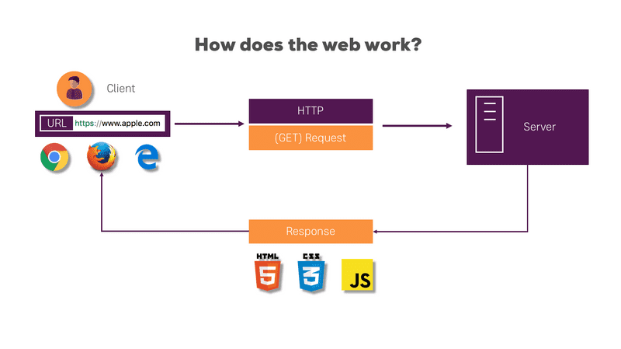
How does the web works?

Slide 14
Structure of a Typical Web Page
HTML Structure:
Header Section: Contains metadata, links to external resources (CSS, JavaScript), and document information.
Body Section: Contains the main content of the web page, including text, images, videos, forms, and interactive elements.
Footer Section: Often contains additional information such as copyright notices, contact details, and links to related pages.
Client-Side Technologies:
CSS (Cascading Style Sheets): Defines the presentation and layout of HTML elements on a web page.
JavaScript: Adds interactivity and dynamic behavior to web pages, allowing for user input validation, animations, and real-time updates.

Slide 15
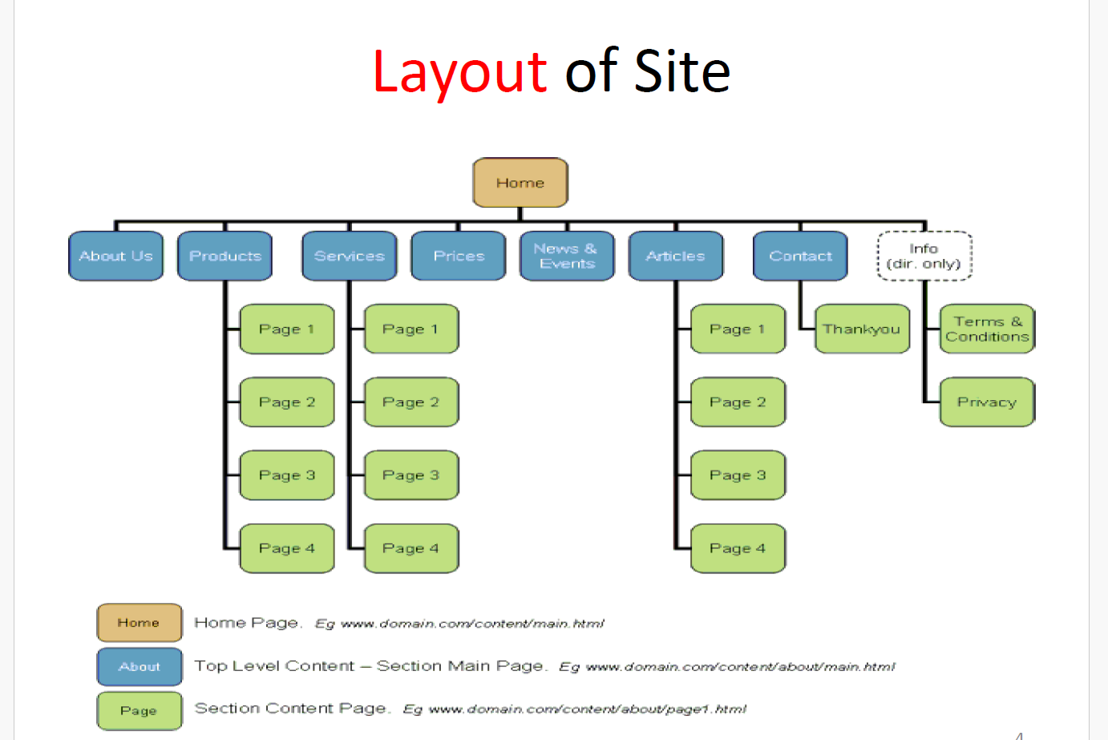

Slide 16
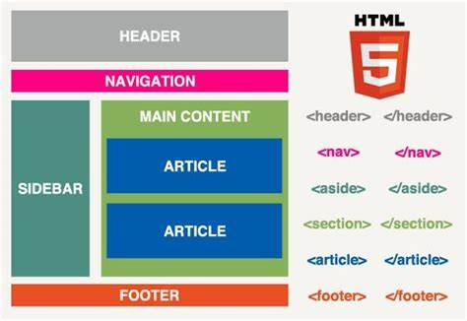

Slide 17
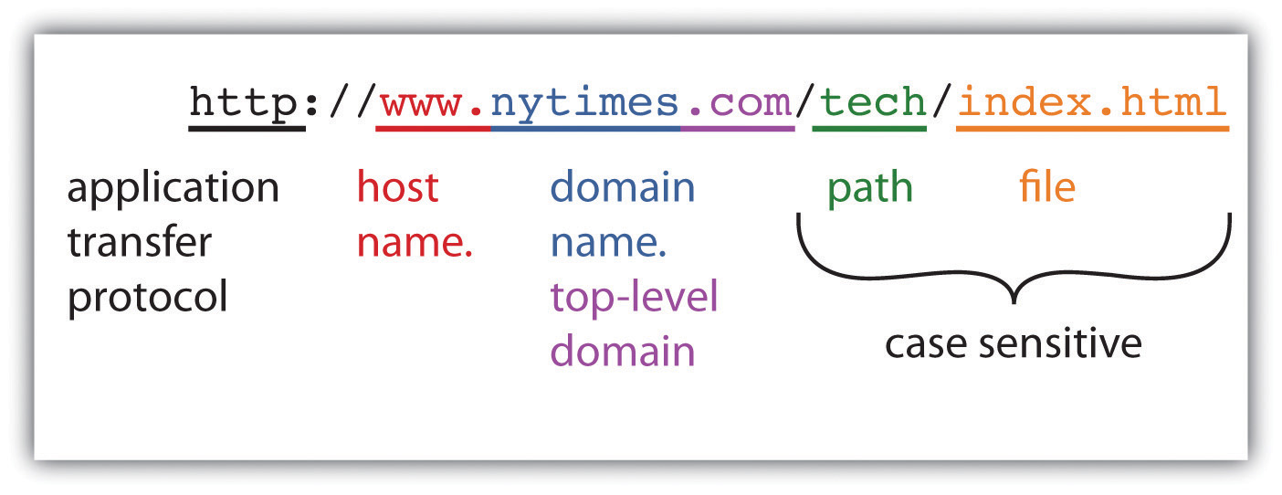
Structure of the web address

Slide 18
Link analysis
Link analysis in a web-based information system involves examining the relationships and connections between web pages through hyperlinks.
It is a crucial aspect of understanding the structure, behavior, and influence of web pages within a website or across the entire World Wide Web.
Method of Link Analysis
Graph Theory:
Nodes and Edges: Represents web pages as nodes and hyperlinks as edges in a graph, allowing for the application of graph theory algorithms to analyze the structure and relationships.
Applications of Link Analysis
SEO and Digital Marketing:
Link Building: Identifies opportunities for acquiring high-quality inbound links to improve search engine rankings.
Competitor Analysis: Analyzes competitors’ link profiles to identify strengths and weaknesses in their SEO strategies.
Website Design and Navigation:
Information Architecture: Designs intuitive navigation structures that enhance user experience and facilitate content discovery.

Slide 19
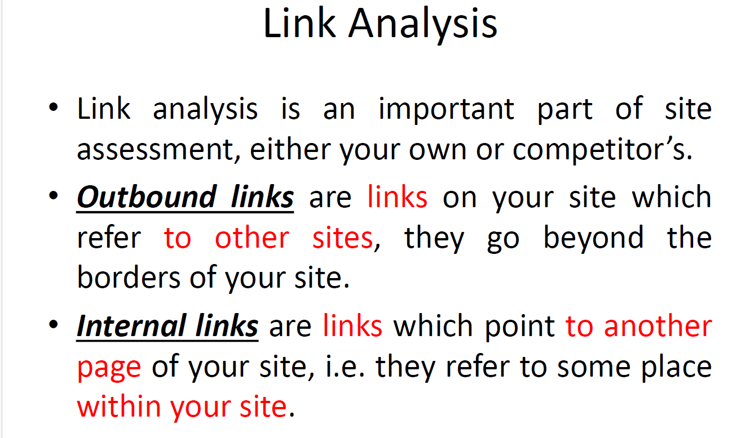

Slide 20
Website navigation
Website navigation is the process of designing and implementing a system that allows users to browse through a website's pages and sections efficiently.
It includes menus, links, buttons, and any other elements that guide users through the site's content.
Effective navigation improves user experience by making it easy for visitors to locate content and understand the structure of the site.

Slide 21
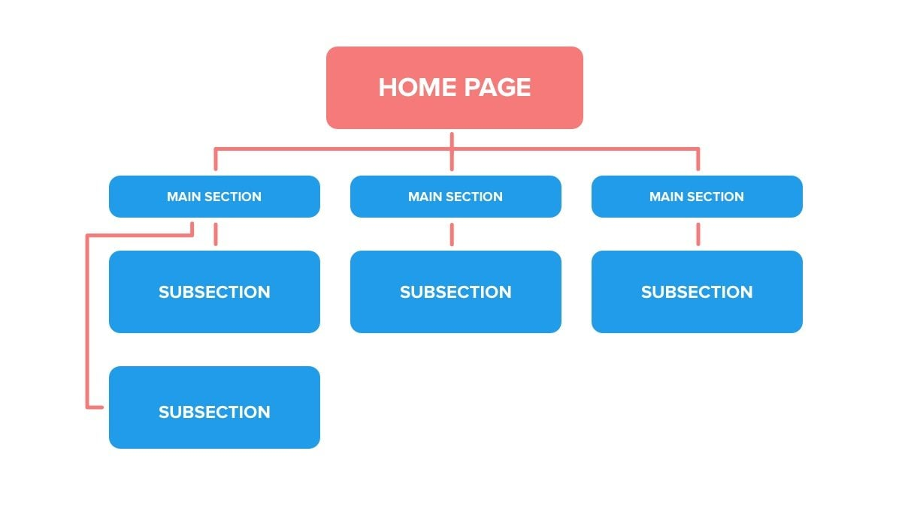
Hierarchical website naviagation
This type of navigation reflects the logical structure of the website, often represented as a tree where the homepage is the root, and other pages branch out in levels.
It organizes content into categories and subcategories.
Usage Example: A university website might use hierarchical navigation to organize information by sections such as “Admissions,” “Academics,” “Research,” “Campus Life,” and within “Academics,” there might be subcategories like “Undergraduate Programs,” “Graduate Programs,” “Departments,” and “Online Learning.”

Slide 22
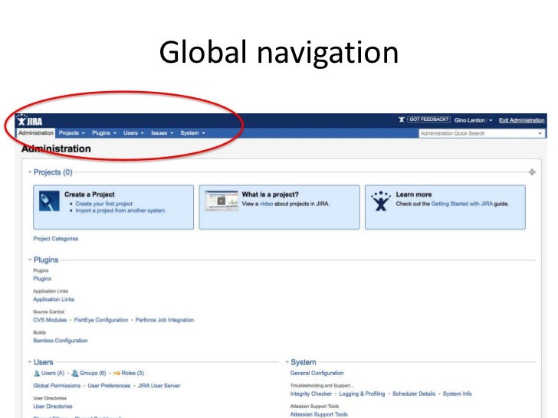
Global website navigation
Global navigation provides consistent links that are available on every page of the website, usually found at the top or side of the page. It allows users to access the main sections of the website from anywhere within the site.
A software company’s website might have a global navigation menu with links to “Home,” “Products,” “Solutions,” “Pricing,” “About Us,” and “Contact” that appear at the top of every page.
Usage Example: An e-commerce website like Amazon uses global navigation to provide links to “Departments,” “Deals,” “Orders,” “Cart,” and “Account” consistently across all pages, ensuring users can quickly access these sections regardless of their current location on the site.

Slide 23
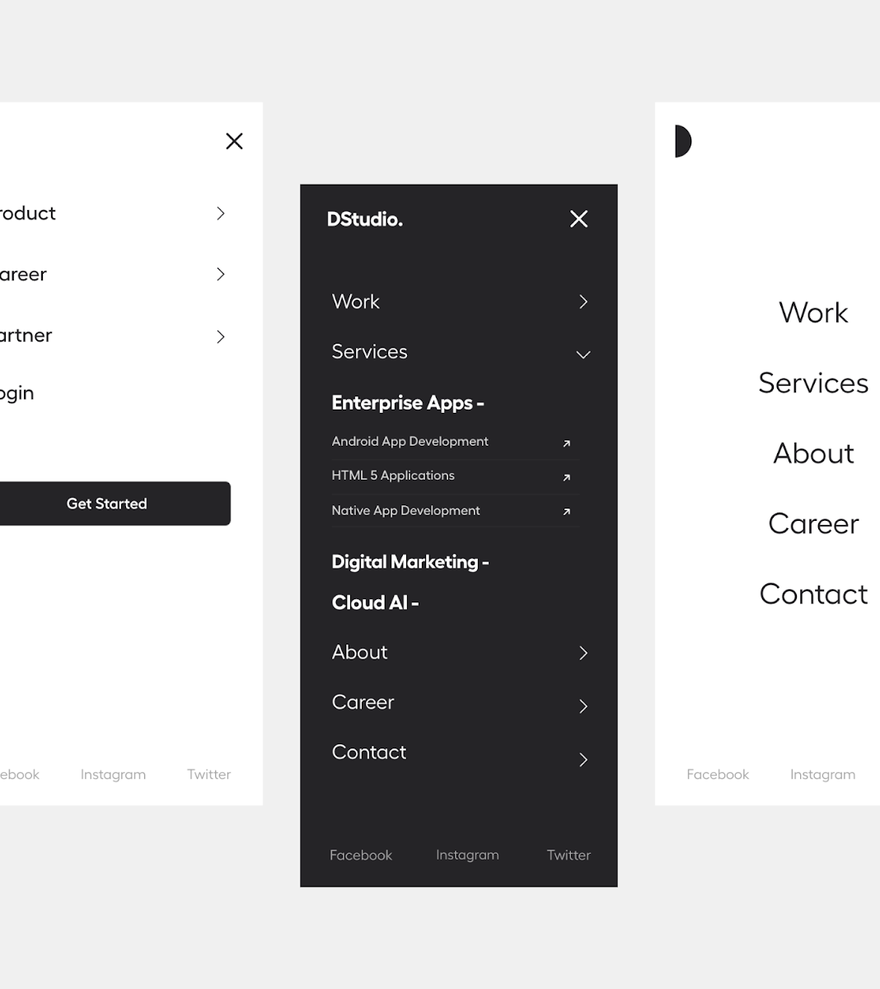
Local Navigation
Local navigation helps users explore a specific section or category of the website. It is usually found within subpages and provides links related to the current section.
On the “Products” page of a software company’s website, local navigation might include links to different product lines like “CRM Software,” “ERP Solutions,” and “Project Management Tools.”
Usage Example: On a university’s website, when a user navigates to the “Academics” section, local navigation might include links to “Undergraduate Programs,” “Graduate Programs,” “Departments,” “Faculty,” and “Course Catalog.” If the user selects “Undergraduate Programs,” the local navigation might update to show links specific to that category, such as “Program Requirements,” “Admissions Process,” and “Scholarships.”

Slide 24
Web mining
Web mining is the process of extracting useful information and insights from web data, including web content, web structure, and web usage data.
It involves using data mining techniques to analyze data from the World Wide Web and derive meaningful patterns and trends.
Types of Web Mining
Web Content Mining:
Description: Focuses on extracting information from the content of web pages. This includes text, images, videos, and other forms of multimedia. Techniques such as natural language processing (NLP), information retrieval, and machine learning are often used.
Example: Sentiment Analysis: Analyzing social media posts, blog entries, and product reviews to determine public sentiment about a particular product, service, or topic. For instance, a company might mine Twitter data to gauge customer reactions to a new product launch.
Topic Modeling: Extracting topics from a large collection of documents (e.g., news articles) to understand the prevalent themes and trends.

Slide 25
Web mining
Web Structure Mining:
Description: Focuses on the structure of the web, including the analysis of the link structure between web pages. It involves studying the hyperlinks and the relationships between different web pages and websites.
Example:
PageRank Algorithm: Google’s PageRank algorithm uses web structure mining to rank web pages based on their importance. Pages with more inbound links from other important pages are ranked higher.
Community Detection: Identifying communities or clusters of websites that frequently link to each other, which can reveal related groups or thematic areas.

Slide 26
Web mining
Web Usage Mining:
Description: Involves analyzing web log data to understand user behavior on websites. This includes tracking user clicks, navigation patterns, and interaction with web applications.
Example:
Clickstream Analysis: Analyzing the sequence of clicks made by users to understand their navigation patterns, identify popular pages, and detect potential issues in the user flow.
Personalization: Recommending products or content based on users’ past behavior. For instance, an e-commerce website might use web usage mining to suggest products to users based on their browsing and purchase history.

Slide 27
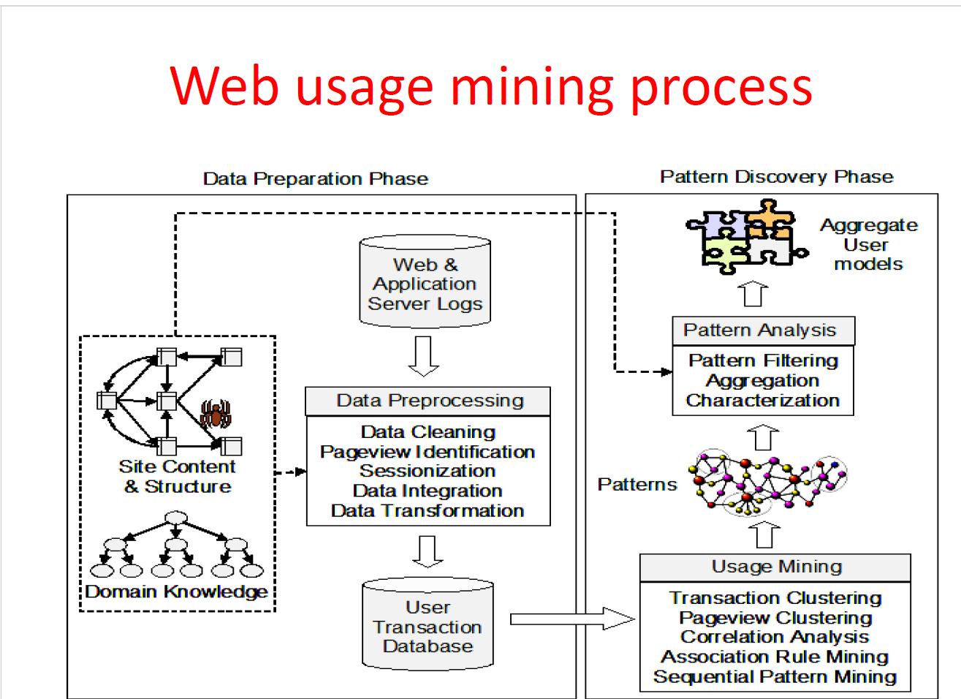
Web mining process

Slide 28
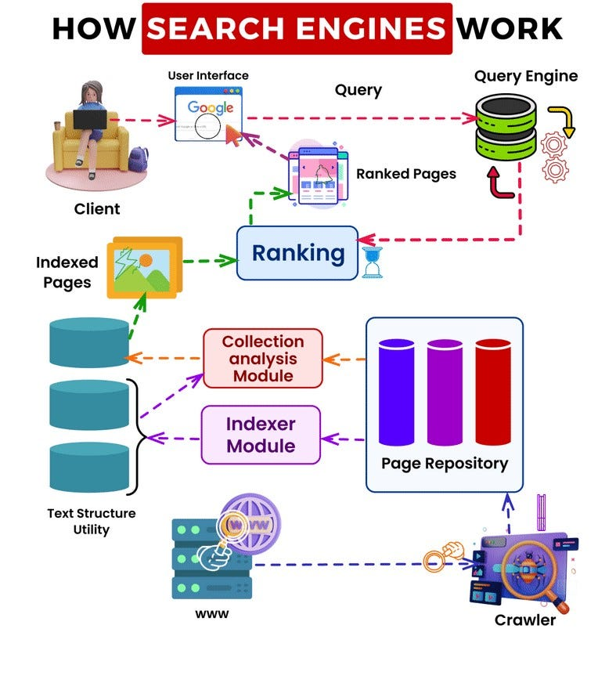

Slide 29
Search Engine
A search engine is a software system designed to carry out web searches, which means searching the World Wide Web in a systematic way for particular information specified in a textual web search query.
The search results are typically presented in a line of results, often referred to as search engine results pages (SERPs).

Slide 30
Crawling:
Description: Crawling is the process by which search engines discover new and updated web pages. Search engines use automated software called crawlers, spiders, or bots to scan the web.
How it Works: Crawlers start from a list of known URLs and follow links from those pages to discover additional pages. They retrieve the content of these pages and follow hyperlinks to other pages, creating an extensive map of the web’s content.
Example: Googlebot is Google’s web crawler, which continuously scans the web to update Google’s index.

Slide 31
Indexing:
Description: Indexing involves processing and storing the information gathered by the crawlers in a structured format that allows for efficient retrieval.
How it Works: During indexing, the search engine analyzes the content of each page, including text, metadata, images, and video, and stores it in a massive database. Important aspects like keywords, page titles, and descriptions are cataloged.
Example: When Googlebot crawls a webpage about "best hiking trails," it will index the page by noting its content, keywords, and relevance to hiking.

Slide 32
Ranking:
Description: Ranking is the process of ordering the search results by relevance to the user’s query.
How it Works: Search engines use complex algorithms to determine the relevance of each indexed page to the search query. These algorithms consider hundreds of factors, such as keyword presence, page quality, user engagement, and backlinks.
Example: For a query like "best hiking trails," the search engine will prioritize pages that are well-regarded by users, contain high-quality information, and have been linked to by other reputable sites.

Slide 33
Key Components of a Search Engine
Crawler (Spider/Bot):
Software that systematically browses the web to collect information.
Indexer:
Processes and organizes the data collected by the crawler.
Database:
A storage system for the indexed data, allowing quick retrieval during searches.
Search Algorithm:
The formula used to determine the relevance and ranking of web pages.
User Interface:
The front-end interface where users input their queries and view results.

Slide 34
Why do search engine give different results?
Search Algorithms:
Description: Each search engine uses its own proprietary algorithm to rank and display search results. These algorithms consider different factors and weigh them differently, resulting in variations in search results.
Example: Google’s algorithm may prioritize user engagement metrics and backlinks, while Bing might place more emphasis on social signals and multimedia content.
Indexing Processes:
Description: The way search engines crawl and index web pages can vary, leading to differences in the available data for searches. Some search engines might index more frequently or comprehensively than others.
Example: Googlebot might crawl and index a website more frequently than Bing’s crawler, resulting in more up-to-date content on Google’s search results.
User Personalization:
Description: Search engines personalize results based on user behavior, preferences, location, and search history. This means different users may see different results for the same query.
Example: A search for “coffee shops” might yield different results for two users based on their location. A user in New York will see nearby coffee shops, while a user in San Francisco will see results relevant to their area.

Slide 35
Why do search engine give different results?
Data Sources:
Description: Search engines may have access to different data sources and partnerships, which can influence the content they display in search results.
Example: Google might show detailed information from its Knowledge Graph and integrations with services like Google Maps and Google Reviews, while Bing might show data from Microsoft services and partners.
Focus Areas:
Description: Different search engines may focus on different types of content or regions. Some might specialize in specific markets or types of information.
Example: Baidu, being the leading search engine in China, provides results tailored to Chinese users and local content, which might differ significantly from Google’s results for the same query.
SEO Strategies:
Description: Websites optimize their content differently for various search engines (SEO strategies). Since each search engine has different ranking factors, the effectiveness of these optimizations can vary.
Example: A website might perform better on Google because it has been optimized specifically for Google’s ranking factors, while the same site might rank lower on Bing.

Slide 36
7 different naviagations
Site Structure Navigation
Description: Site structure navigation refers to the overall organization and hierarchy of a website's content. This type of navigation helps users understand the relationship between different sections of the site and find information efficiently.
Example:
University Website:
Home
About
History
Mission & Vision
Academics
Undergraduate Programs
Graduate Programs
Research
Admissions

Slide 37
7 different naviagations
Function Navigation
Description: Function navigation involves links and menus that provide access to specific functions or actions within the website, often related to user tasks or interactions.
Example:
Banking Website:
Login
Transfer Funds
Pay Bills
View Statements
Apply for a Loan

Slide 38
7 different naviagations
Direct Navigation
Description: Direct navigation allows users to go directly to a specific page or section without having to navigate through the site’s hierarchy.
Example:
Search Bar: Allows users to enter keywords to directly find the page or information they need.
URL Entry: Users type the exact URL of the page they want to visit.
Purpose: To provide quick access to specific information or pages, reducing the time and effort needed to navigate through the site.

Slide 39
7 different naviagations
Reference Navigation
Description: Reference navigation involves links that refer users to additional information or resources related to the content they are currently viewing.
Example:
Article or Blog Post:
"See Also" section with links to related articles.
Footnotes or citations with links to source material.
Product Page:
"Customers Also Bought" section with links to related products.
References to manufacturer websites or detailed product specifications.
Purpose: To provide users with additional context or related information, enhancing their understanding and engagement with the content.

Slide 40
7 different naviagations
Dynamic Navigation
Description: Dynamic navigation adapts based on user interactions or preferences, providing a personalized or context-sensitive experience.
Example:
Personalized Recommendations: E-commerce sites suggesting products based on past purchases or browsing history.
Adaptive Menus: Navigation menus that change based on user role or past interactions (e.g., different options for logged-in users).
Purpose: To offer a tailored browsing experience, making navigation more relevant and efficient for individual users.

Slide 41
7 different naviagations
Breadcrumb Navigation
Description: Breadcrumb navigation provides a trail of links that show the user’s path from the homepage to their current location within the site.
Example:
E-commerce Site:
Home > Electronics > Mobile Phones > Smartphones > Brand XYZ
Educational Site:
Home > Courses > Computer Science > Introduction to Programming
Purpose: To help users understand their location within the site’s hierarchy and easily navigate back to previous sections.

Slide 42
7 different naviagations
Step Navigation
Description: Step navigation guides users through a multi-step process or workflow, often used in forms, checkout processes, or tutorials.
Example:
Online Checkout:
Step 1: Cart Summary
Step 2: Shipping Information
Step 3: Payment Details
Step 4: Review Order

Slide 43
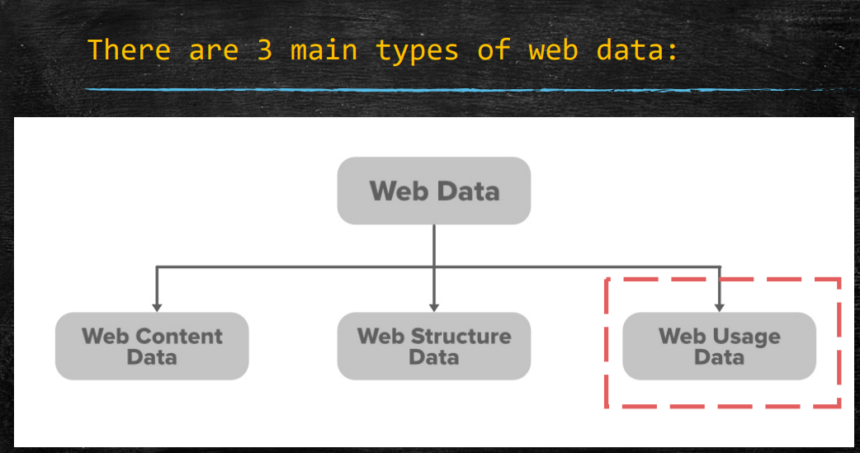

Slide 44
Web Content Data
Description: Web content data refers to the actual information or content present on a web page. This includes text, images, videos, and other multimedia elements.
Examples:
Textual Data: Articles, blog posts, product descriptions, reviews, and any written content.
Example: An e-commerce website's product page containing a detailed description of a smartphone, including specifications, features, and user reviews.
Multimedia Data: Images, videos, audio files, and other non-text content.
Example: A news website featuring images and videos alongside articles to provide visual context to the news story.
Meta Data: Information about the content, such as titles, keywords, and descriptions, often used by search engines to index and rank pages.
Example: The meta description of a webpage, which appears in search engine results to summarize the content of the page.

Slide 45
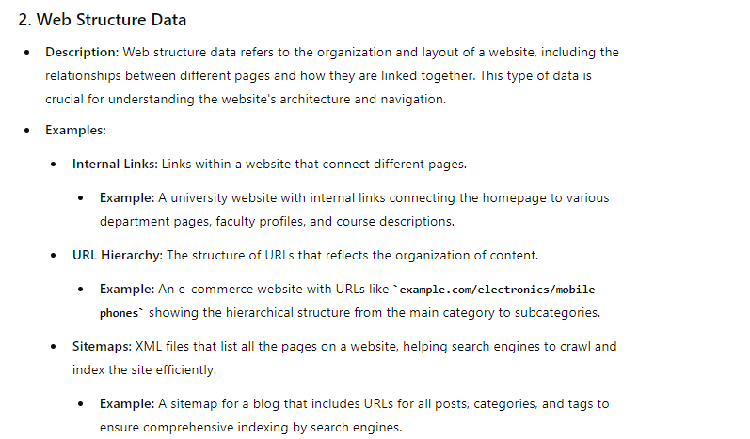

Slide 46
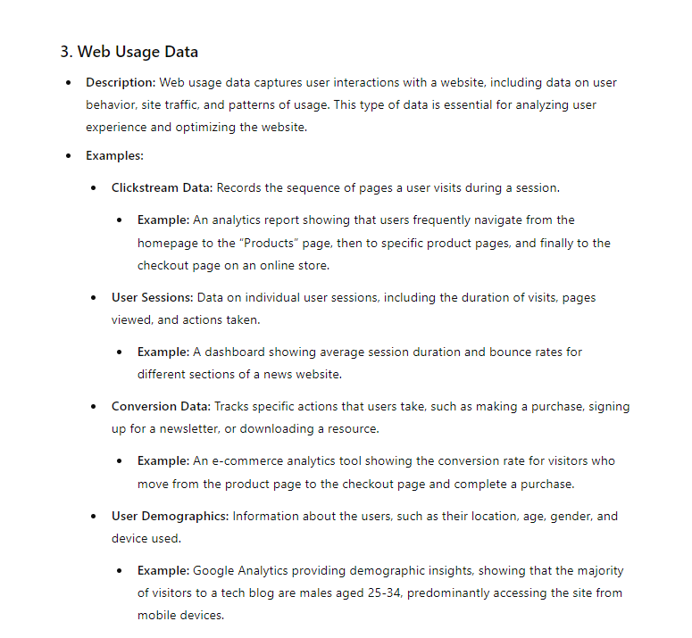

Slide 47
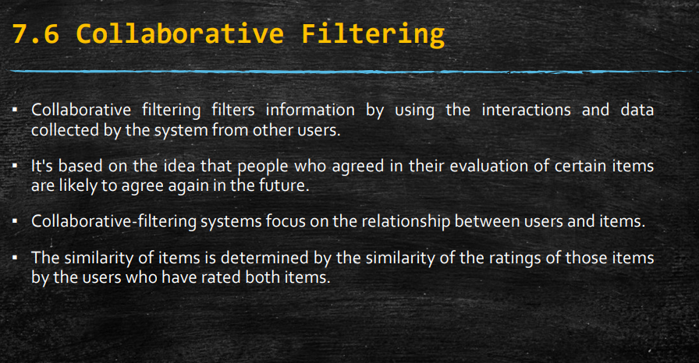

Slide 48
Collaborative Filtering
Collaborative filtering is a technique used in recommendation systems to predict a user's preferences for items (such as movies, books, or products) by collecting and analyzing information from many users. The basic idea behind collaborative filtering is that if a person A has similar preferences to a person B on certain items, A is more likely to have similar preferences to B on other items as well.
Both user-based and item-based collaborative filtering rely on constructing a similarity matrix between users or items, where similarity can be measured using metrics like cosine similarity, Pearson correlation, or Jaccard similarity.
Collaborative filtering has been widely used by companies like Amazon, Netflix, and Spotify to provide personalized recommendations to their users based on their historical interactions with items and the preferences of similar users
There are two main types of collaborative filtering:
User-based collaborative filtering: This approach recommends items to a target user by finding other users who are similar to that user based on their item ratings or preferences. It then suggests items that those similar users have liked or rated highly.
Item-based collaborative filtering: In this method, similarities between items are calculated based on the ratings given to those items by users. When a user needs recommendations, the system identifies items similar to the ones they have liked or interacted with in the past.

Slide 49
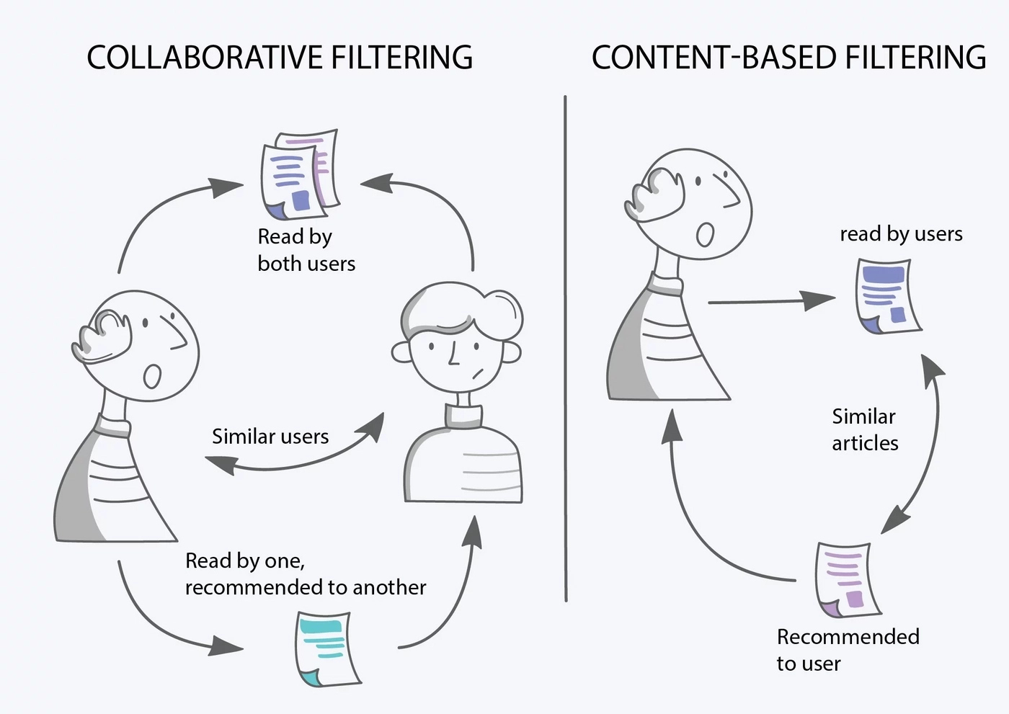

Slide 50
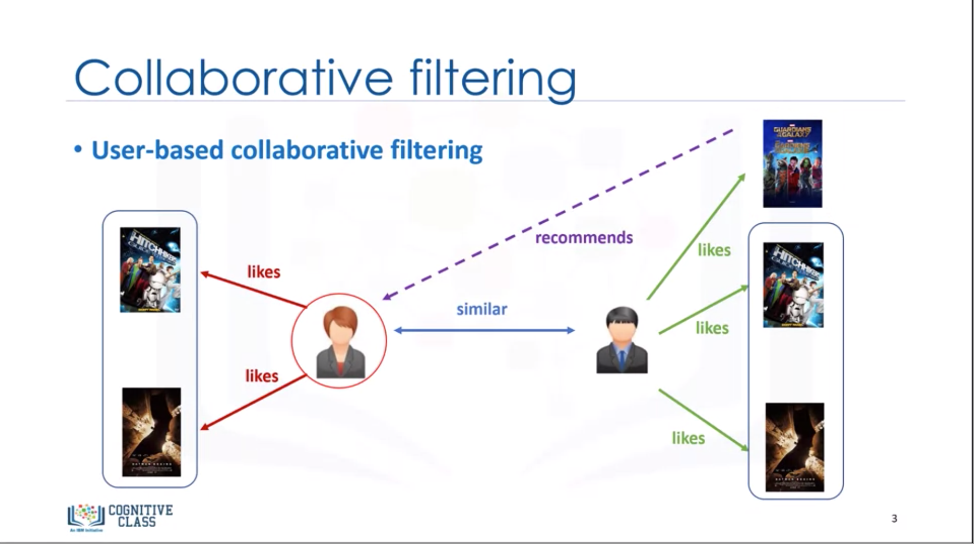

Slide 51
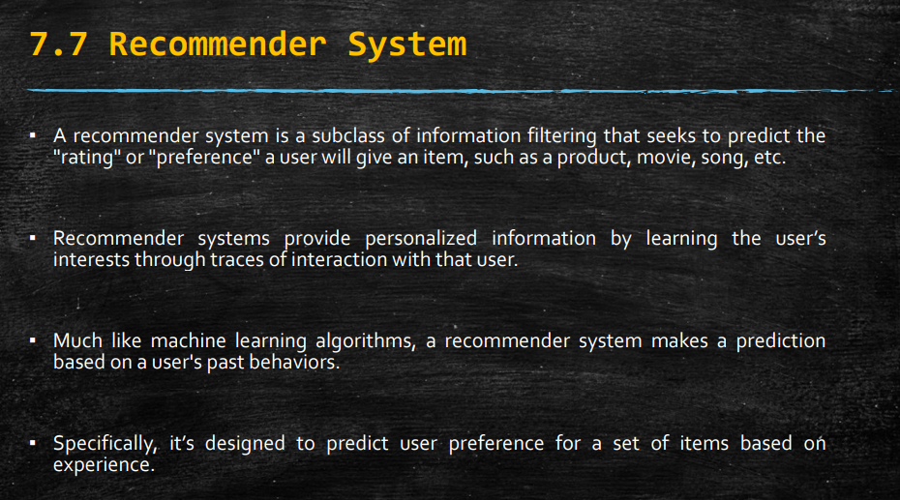

Slide 52
Recommender systems are widely used on the web to personalize content and recommendations for users based on their preferences and behavior. Here’s how recommender systems are typically implemented in web applications:
Data Collection and Storage: Websites collect data about user interactions such as clicks, purchases, ratings, and searches. This data is stored in databases or data warehouses for further analysis.
Data Preprocessing: Before building a recommender system, the collected data needs to be preprocessed. This may involve cleaning the data, handling missing values, and transforming it into a suitable format for analysis.
Recommendation Algorithms

Slide 53
Recommendation Algorithms: There are various algorithms used in recommender systems, including:
Collaborative Filtering: As discussed earlier, collaborative filtering methods like user-based or item-based filtering are popular choices. These algorithms leverage user-item interaction data to recommend items to users.
Content-based Filtering: This method recommends items similar to those the user has liked or interacted with before, based on item attributes or content.
Hybrid Methods: Combining collaborative and content-based filtering to improve recommendation accuracy and handle cold start problems.

Slide 54
Collective Intelligence
Collective intelligence refers to the capability of a group of individuals to collaborate effectively and pool their knowledge, skills, and perspectives to achieve a common goal. It leverages the diverse expertise and insights of group members to solve problems, make decisions, innovate, and produce outcomes that are often superior to what could be achieved by individuals working alone.
Key aspects of collective intelligence include:
Collaboration: Members of a group interact and cooperate, sharing information, ideas, and resources towards a common objective.
Diversity: Groups benefit from the diversity of knowledge, perspectives, experiences, and skills among their members. This diversity contributes to richer discussions, broader problem-solving approaches, and more innovative solutions.
Aggregation: Collective intelligence involves aggregating individual contributions, opinions, or decisions into a coherent whole that reflects the collective wisdom of the group.
Decision Making: Groups use various mechanisms, such as voting, consensus-building, or decentralized decision-making, to reach decisions that are accepted and supported by the majority.
Information Sharing: Effective communication and information sharing among group members are essential for leveraging collective intelligence. Technologies like social media, online forums, and collaborative platforms facilitate this process.
Emergence: Collective intelligence often leads to emergent properties or outcomes that are not explicitly planned but arise from the interactions and dynamics within the group. These emergent properties can be novel insights, solutions, or innovations.

Slide 55
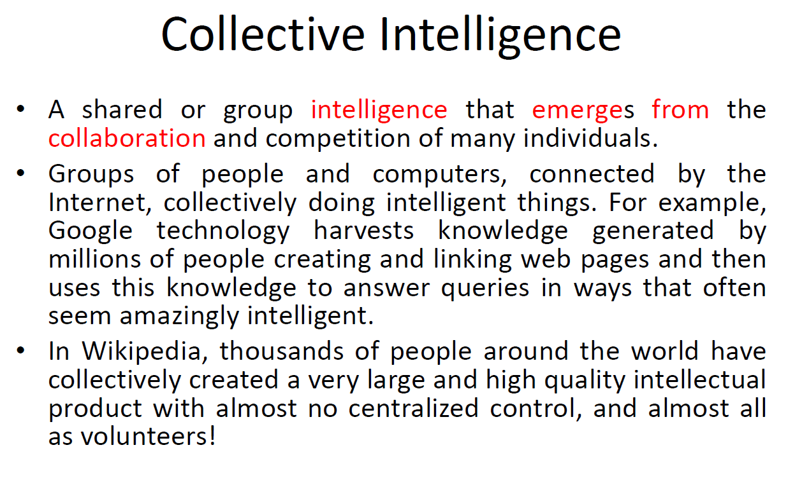

Slide 56
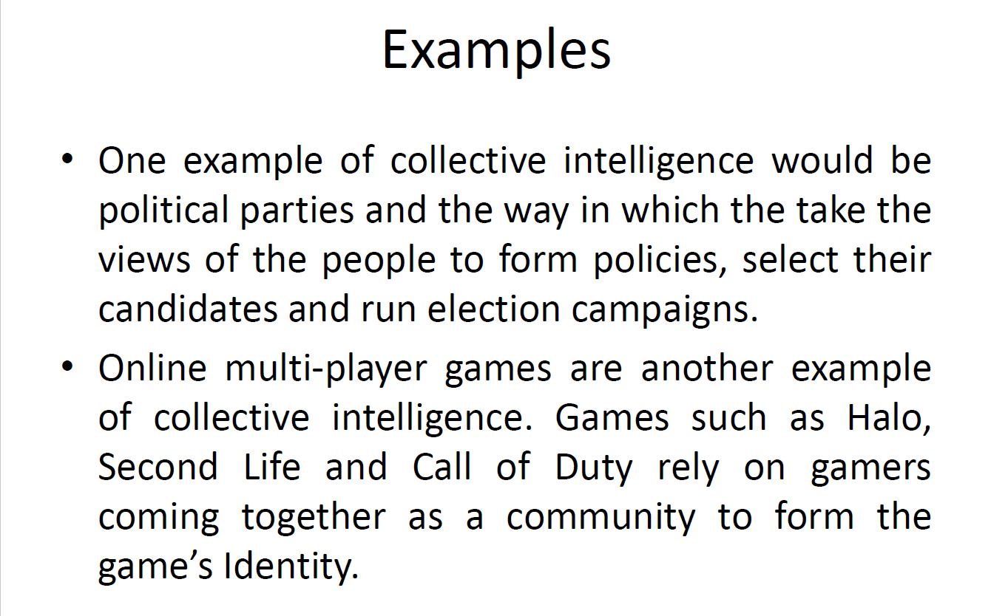

Slide 57
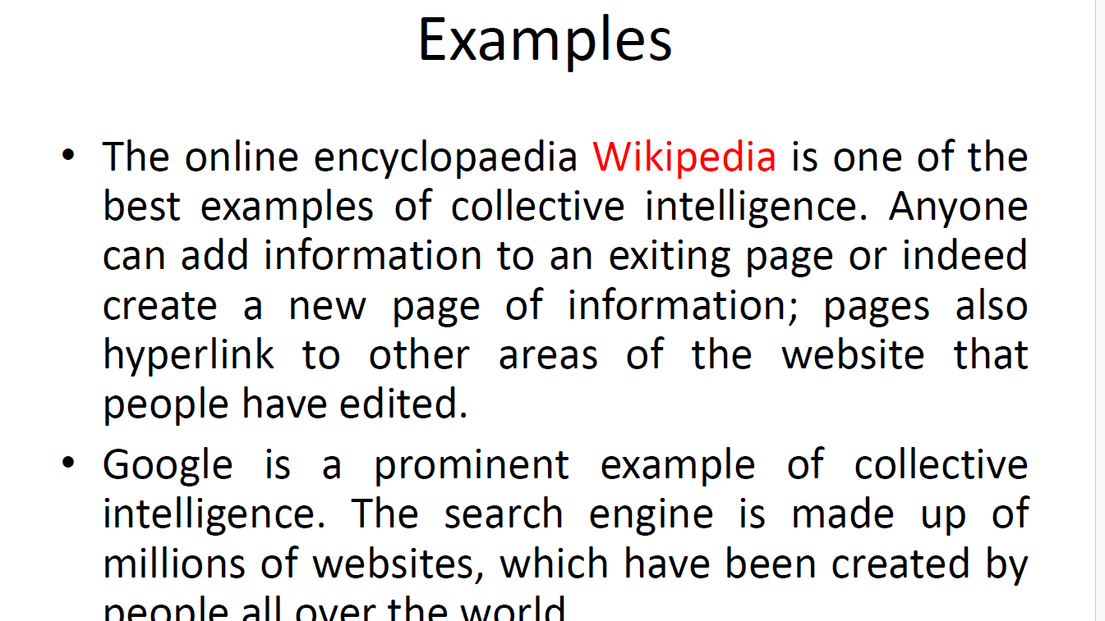

Slide 58
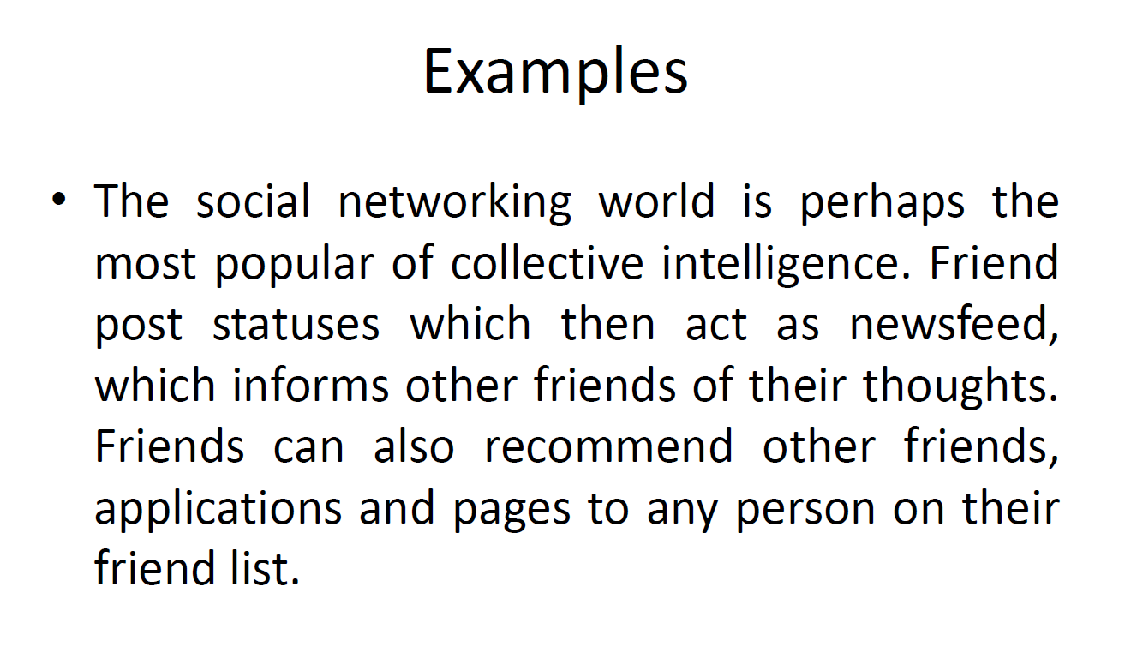

Slide 59
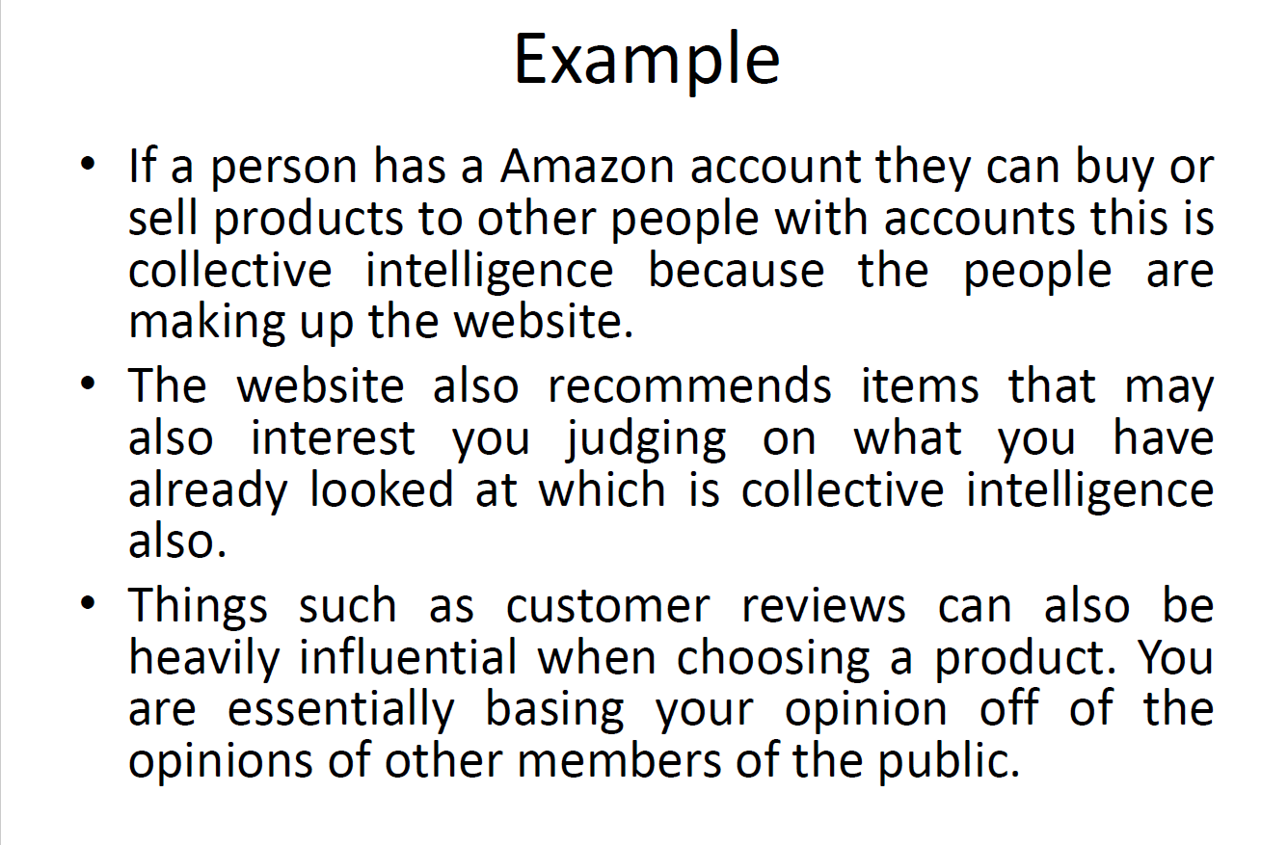

Slide 60
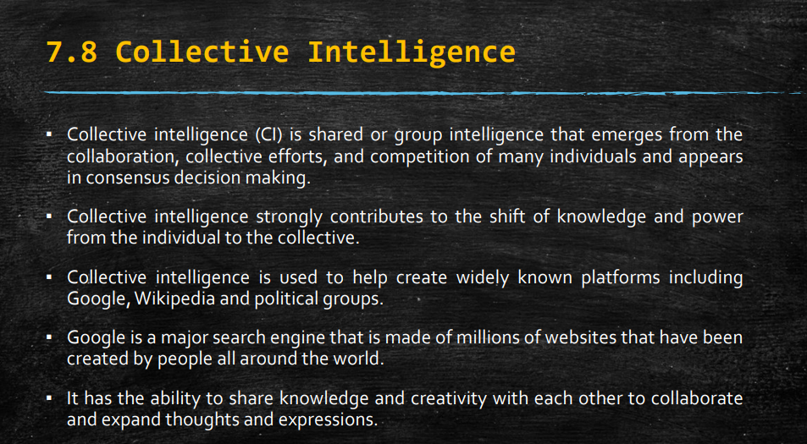

Slide 61
